Slide 1
Left Recursion
Lecture 6
Section 4.3.3
Rokan Uddin Faruqui
Associate Professor
Dept of Computer Science and Engineering University of Chittaong, Bangladesh Email: rokan@cu.ac.bd

Slide 2






Problems with Recursive Descent
Left Recursion
Eliminating Left Recursion
Advantages of Left Recursion
Assignment
Left Recursion

Slide 3





Outline
Problems with Recursive Descent
1
Problems with Recursive Descent
Left Recursion
Eliminating Left Recursion
4
Advantages of Left Recursion
5 Assignment
Left Recursion

Slide 4
A Problem with Recursive Descent Parsers
Problems with Recursive Descent
Suppose the grammar were
S → AB | CD
A → BC | CA | a
B → CA | DB | b
C → BA | AD | a
D → AC | BD | b
How could a top-down parser decide which production for S to use to derive babbb?
Indeed, can babbb be derived?
Left Recursion

Slide 5
A Problem with Recursive Descent Parsers
Problems with Recursive Descent
Suppose the grammar were
S → AB | CD
A → BC | CA | a
B → CA | DB | b
C → BA | AD | a
D → AC | BD | b
How could a top-down parser decide which production for S to use to derive babbb?
Indeed, can babbb be derived?
Left Recursion

Slide 6
Another Problem with Recursive Descent Parsers
Problems with Recursive Descent
S() {
S();
S();
}
Suppose the grammar were
S → S S | a
How could the parser decide how many times to use the production S → S S before using the production S → a?
Left Recursion

Slide 7
Futile Attempt
Problems with Recursive Descent
Futile Attempt
void S() // Match S -> S S | a
{
if (token == a) match(a);
else
{
S();
S();
}
return;
}
Left Recursion

Slide 8


Outline
Left Recursion
1
Problems with Recursive Descent
2 Left Recursion
3 Eliminating Left Recursion
4
Advantages of Left Recursion
5 Assignment
Left Recursion

Slide 9
Left Recursion
Left Recursion
Definition (Left recursive production)
A production is left recursive if it is of the form
A → Aα.
for some nonterminal A and some string α.
Definition (Left recursive grammar)
A grammar is left recursive if there is a derivation
A ⇒⁺ Aα
for some nonterminal A and some string α.
Left Recursion

Slide 11
Left Recursion
Left Recursion
Left Recursion
void A()
// Match A -> A
{
A();
// Process
return;
}
Attempting to match the left-recursive production A → Aα.
Left Recursion

Slide 12
Left Recursion
Left Recursion
S → AB | CD
A → BC | CA | a
B → CA | DB | b
C → BA | AD | a
D → AC | BD | b
Is this grammar left recursive?
Left Recursion
11

Slide 13
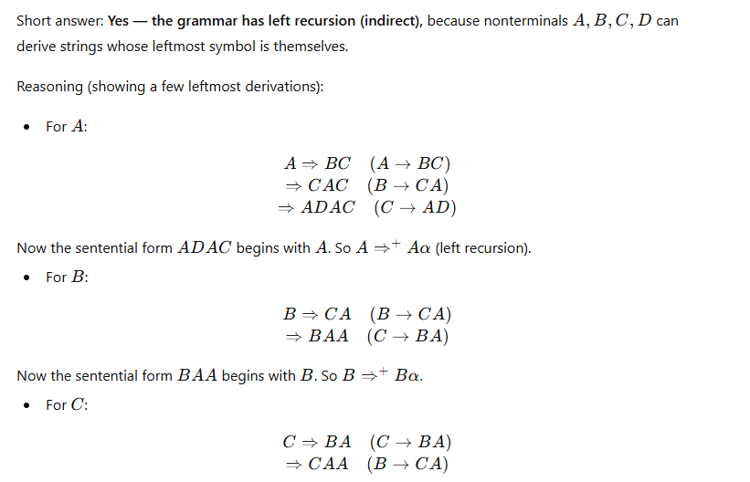

Slide 14
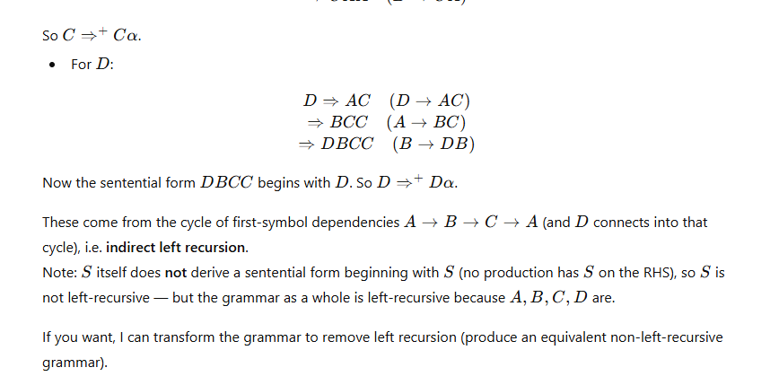

Slide 15
Left Recursion
Left Recursion
Recall that in the earlier example, we added the production
S′ → SS′ | ε,
not the production
S′ → S′S | ε.
Why?
Are they equivalent as far as the language of the grammar is concerned?
Left Recursion

Slide 16

Outline
Eliminating Left Recursion
1
Problems with Recursive Descent
2 Left Recursion
3 Eliminating Left Recursion
4
Advantages of Left Recursion
5 Assignment
Left Recursion

Slide 17
Eliminating Left Recursion
Eliminating Left Recursion
Left recursion in a production may be removed by transforming the grammar in the following way.
Replace
A → Aα | β
with
A → βA′
A′ → αA′ | ε.
where A′ is a new nonterminal.
Left Recursion

Slide 18
Eliminating Left Recursion
Eliminating Left Recursion
Under the original productions, a derivation of βααα is
A ⇒ Aα
⇒ Aαα
⇒ Aααα
⇒ βααα.
Left Recursion

Slide 19
Eliminating Left Recursion
Eliminating Left Recursion
Under the new productions, a derivation of βααα is
A ⇒ βA′
⇒ βαA′
⇒ βααA′
⇒ βαααA′
⇒ βααα.
Left Recursion

Slide 20
Example
Eliminating Left Recursion
Example (Eliminating Left Recursion) Consider the left recursive grammar
E → E + T | T
T → T ∗ F | F F → ( E ) | id
Left Recursion

Slide 21
Example
Eliminating Left Recursion
Example (Eliminating Left Recursion) Apply the transformation to E:
E → T E′
E′ → + T E′ | ε.
Then apply the transformation to T :
T → F T ′
T ′ → ∗ F T ′ | ε.
Left Recursion

Slide 22
Example
Eliminating Left Recursion
Example (Eliminating Left Recursion) Apply the transformation to E:
E → T E′
E′ → + T E′ | ε.
Then apply the transformation to T :
T → F T ′
T ′ → ∗ F T ′ | ε.
Left Recursion

Slide 23
Example
Eliminating Left Recursion
Example (Eliminating Left Recursion) Now the grammar is
E → T E′
E′ → + T E′ | ε T → F T ′
T ′ → ∗ F T ′ | ε F → ( E ) | id
Left Recursion

Slide 24
Eliminating Left Recursion
Eliminating Left Recursion
Eliminating Left Recursion
void Eprime() // Match E' -> + T E'
{
if (token == PLUS)
{
match(PLUS); T();
Eprime();
}
return;
}
This is the function for E′.
Left Recursion

Slide 25






Rokan Uddin Faruqui CSE, CU
5
4
3 Eliminating Left Recursion
2
1
Advantages of Left Recursion
Outline
Assignment
Advantages of Left Recursion
Left Recursion
Problems with Recursive Descent
Left Recursion
22

Slide 26
Advantages of Left Recursion
Advantages of Left Recursion
A left recursive grammar is often more intuitive than the transformed grammar.
A left recursive grammar will match expressions earlier, leading to shallower recursion.
Bottom-up parsing takes advantage of the benefits of left recursion.
Left Recursion

Slide 27
Example
Advantages of Left Recursion
Consider the simple grammar
E → E + E | id
Convert it to
E → id E′
E′ → + E E′ | ε
Left Recursion

Slide 28

Outline
Assignment
1
Problems with Recursive Descent
Left Recursion
Eliminating Left Recursion
4
Advantages of Left Recursion
5 Assignment
Left Recursion

Slide 29
Assignment
Assignment
Homework
4.2.1, 4.2.2.
4.4.1, 4.4.3, 4..4.4
The grammar
R → R ∪ R | R R | R ∗ | ( R ) | a | b
generates all regular expressions over the alphabet {a, b}.
Rewrite the grammar to reflect the precedence rules.
Eliminate left recursion.
Left Recursion

Slide 30
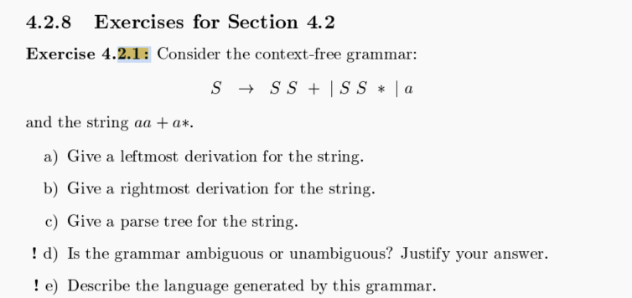

Slide 31
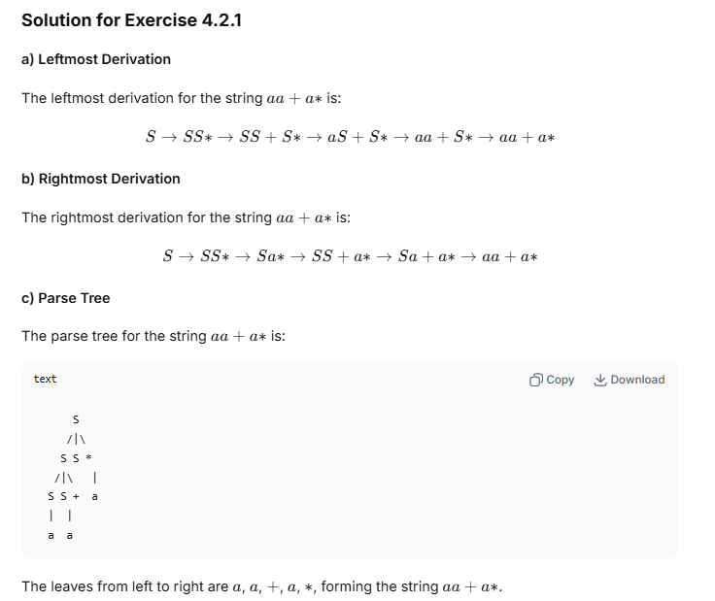

Slide 32
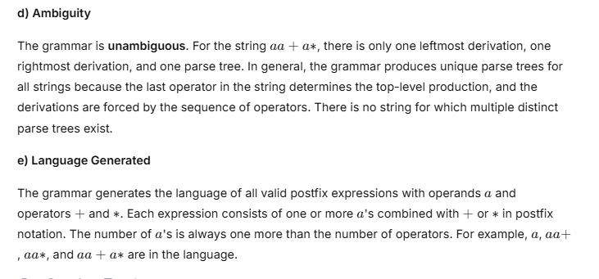

Slide 33
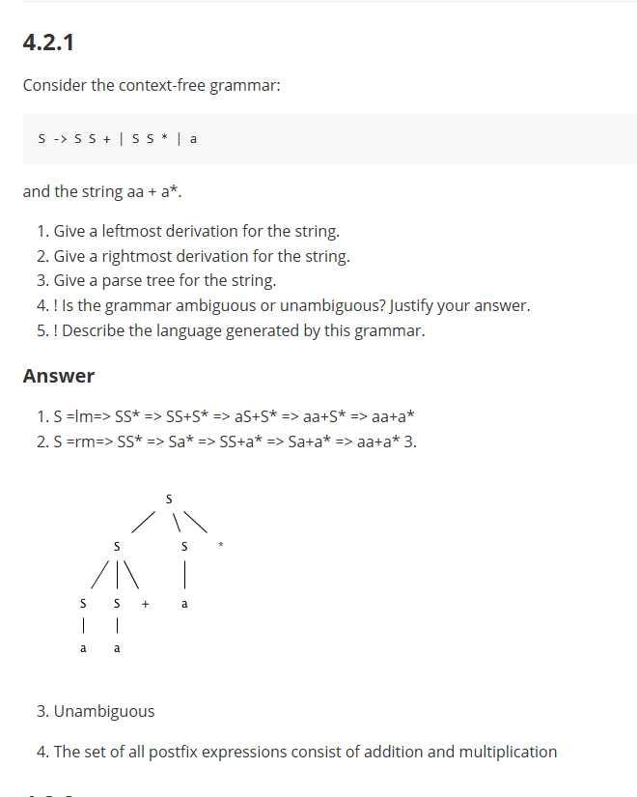

Slide 34
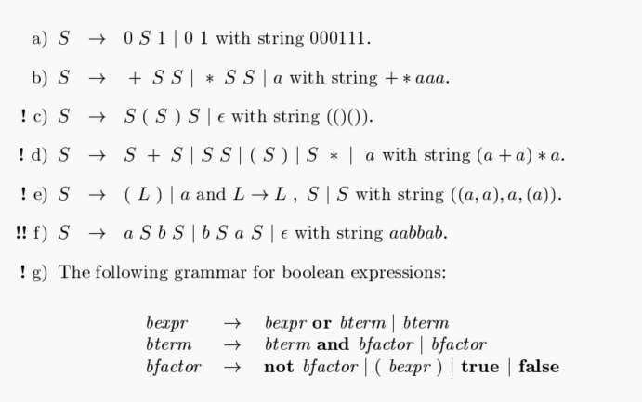

Slide 35
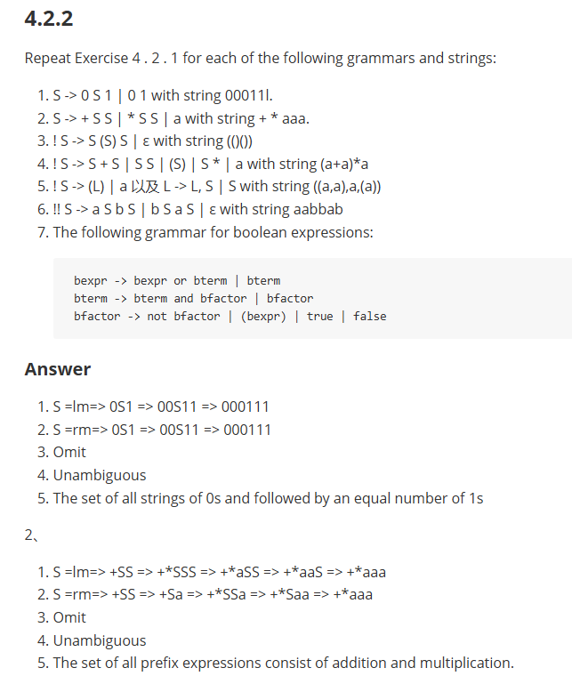

Slide 36
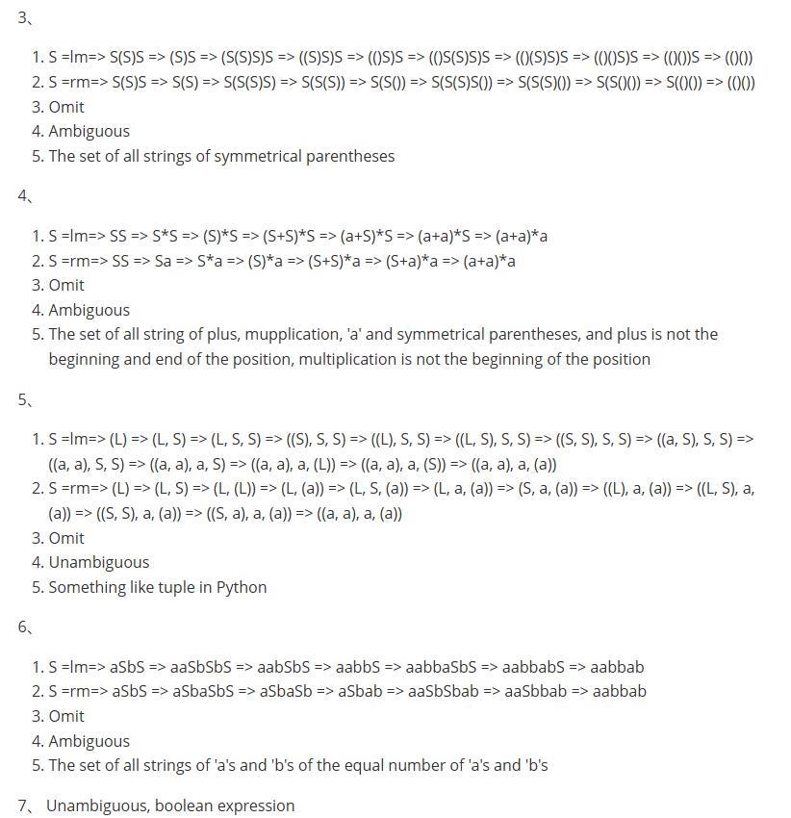

Slide 37
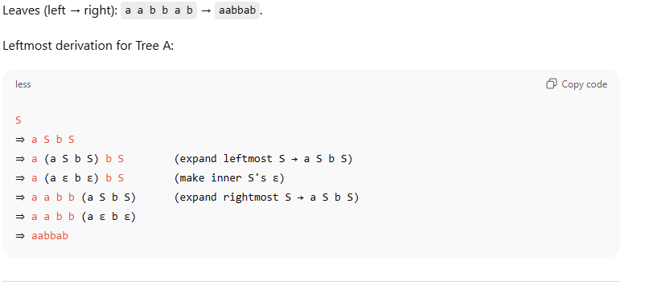
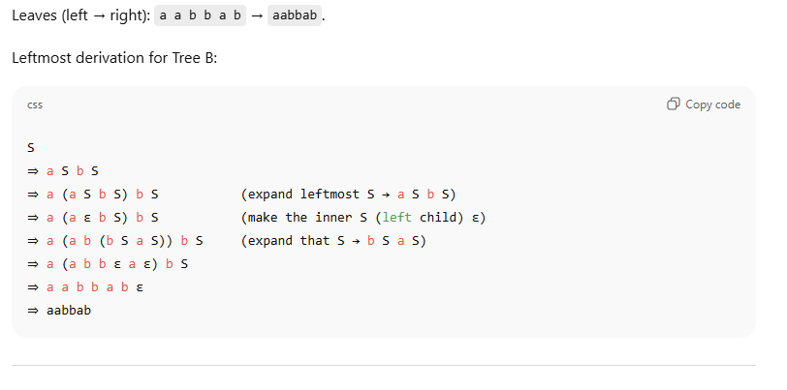
6 number

Slide 39
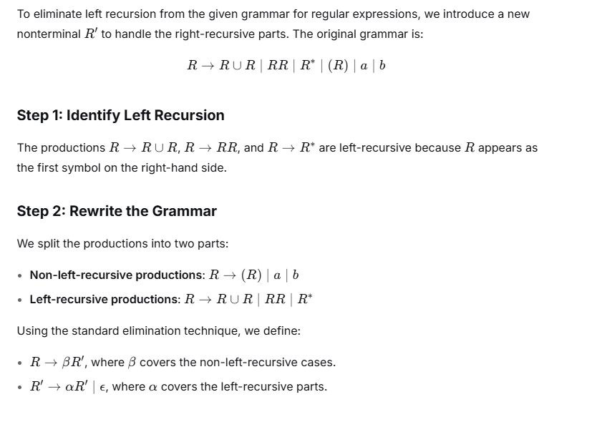

Slide 40
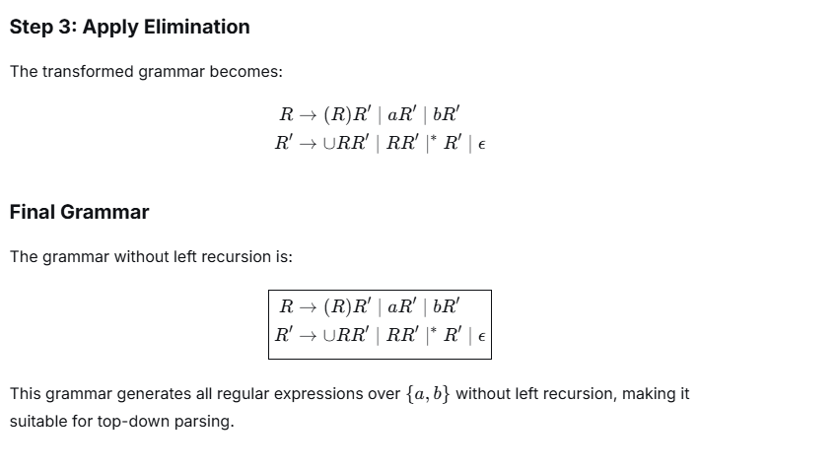

Slide 41
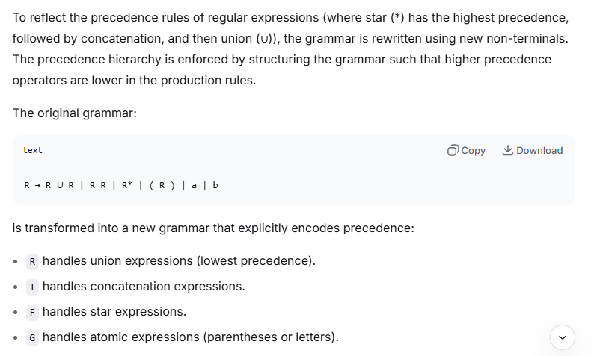

Slide 42
